Slide 1
Progress Report
Frederick Odiase, Victor Sun, Levi Williamson

Slide 2
Overview
Background
Timeline
Methods
Description
Results
Challenges
Expected Outcomes
Progress Report

Slide 3
Introduction

Slide 4
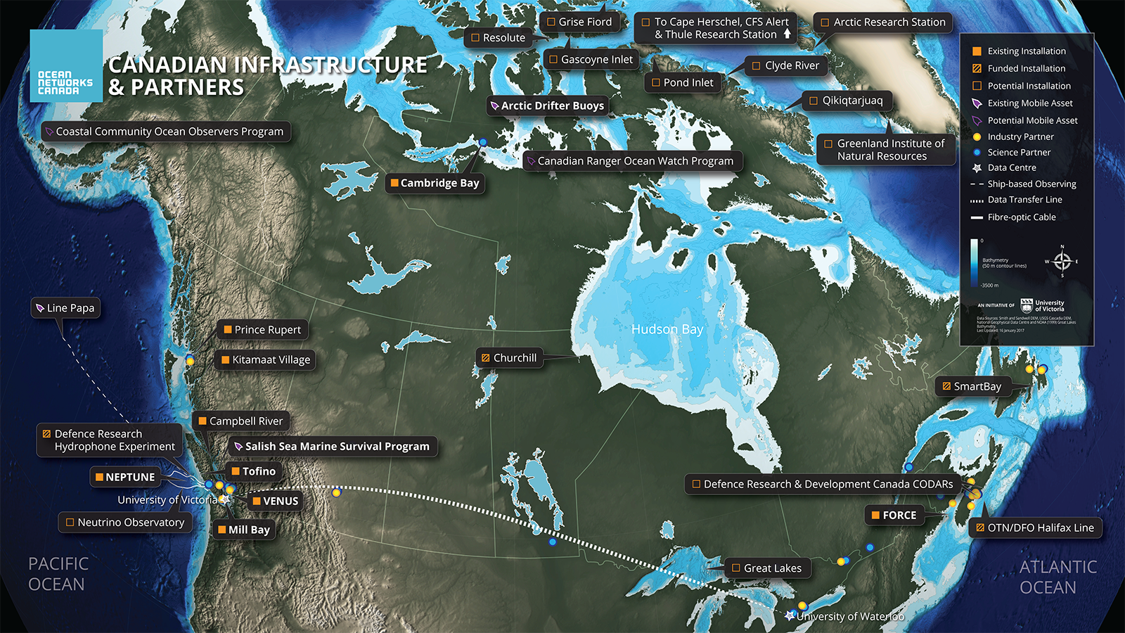
Client - Ocean Networks Canada
Ocean Networks Canada (ONC) monitors the east and west coasts of Canada and the Arctic. ONC is using remote cabled observatories on the seafloor to analyze the environment and to mitigate disasters [1]. Currently ONC is using manpower to repair these systems.

Slide 5
Problem Definition
Need -
Goal -
Objectives -
Constraints -
Benefits -
Ocean Networks Canada lacks autonomous cable-repair robots.
Produce a land-based prototype for an underwater cable-repair robot.
Autonomy, Collision Detection/Resolution, Cable Efficiency, Reliable Connection.
Cost, Operating Area, Materials
Safer, less expensive cable repair operations.

Slide 6
Timeline
Milestone 1: Task Analysis/Timeline Bylaws Schedule | Week 9
Milestone 2: Decision Matrix Go over PDF on making weighted objectives in student resources Create rubric then rank designs | Week 10
Milestone 3: Presentation Outline Problem Identification 3 x Physical & Mechanism Descriptions Analysis Analysis of Results Grading Discussion of Results Recommendation | Week 11
Milestone 4: Design Template for Report Document Title page Executive summary Methodology Graphic Illustrations Descriptions of Proposed Designs Conclusion Citations Cover letter - Outline | Week 12
Milestone 5: Team Evaluations | Week 13 (in-class)
Milstone 6: Cover Letter | Middle of Week 13
Milestone 7: Draft copy To review our draft and make revisions | Around April 1st, before the due date on Apr 7th

Slide 7
Progress

Slide 8
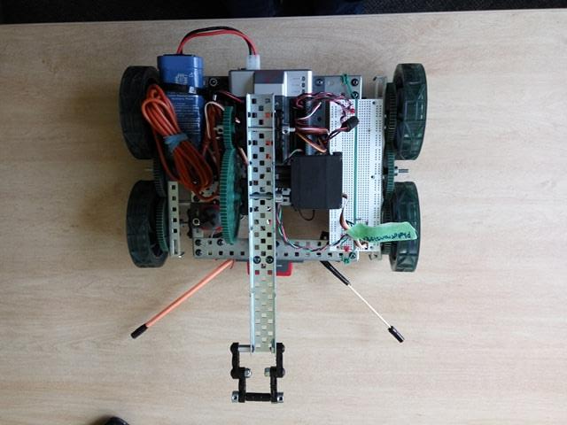
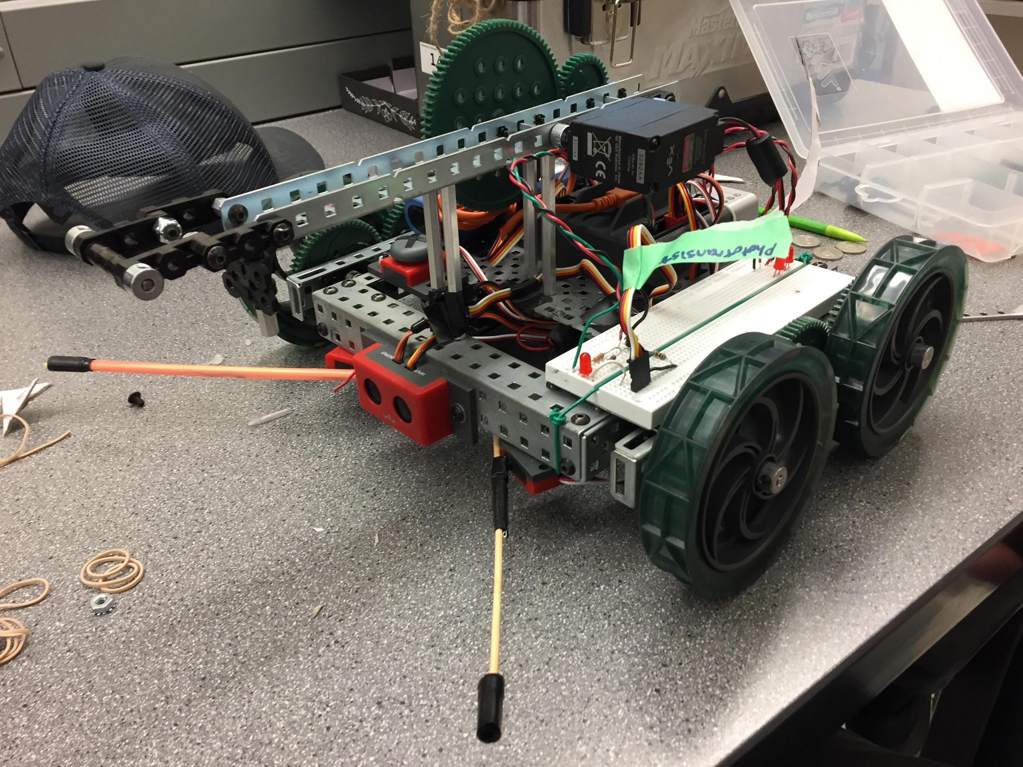
Vex Model G142
Ultrasonic Range Finder with 2 limit switches to detect obstacles
Code for backing up and Sensor Detection
One IR Sensor above Ultrasonic Range Finder
Raised arm mechanism pushes magnet onto beacon
Currently fully autonomous

Slide 9
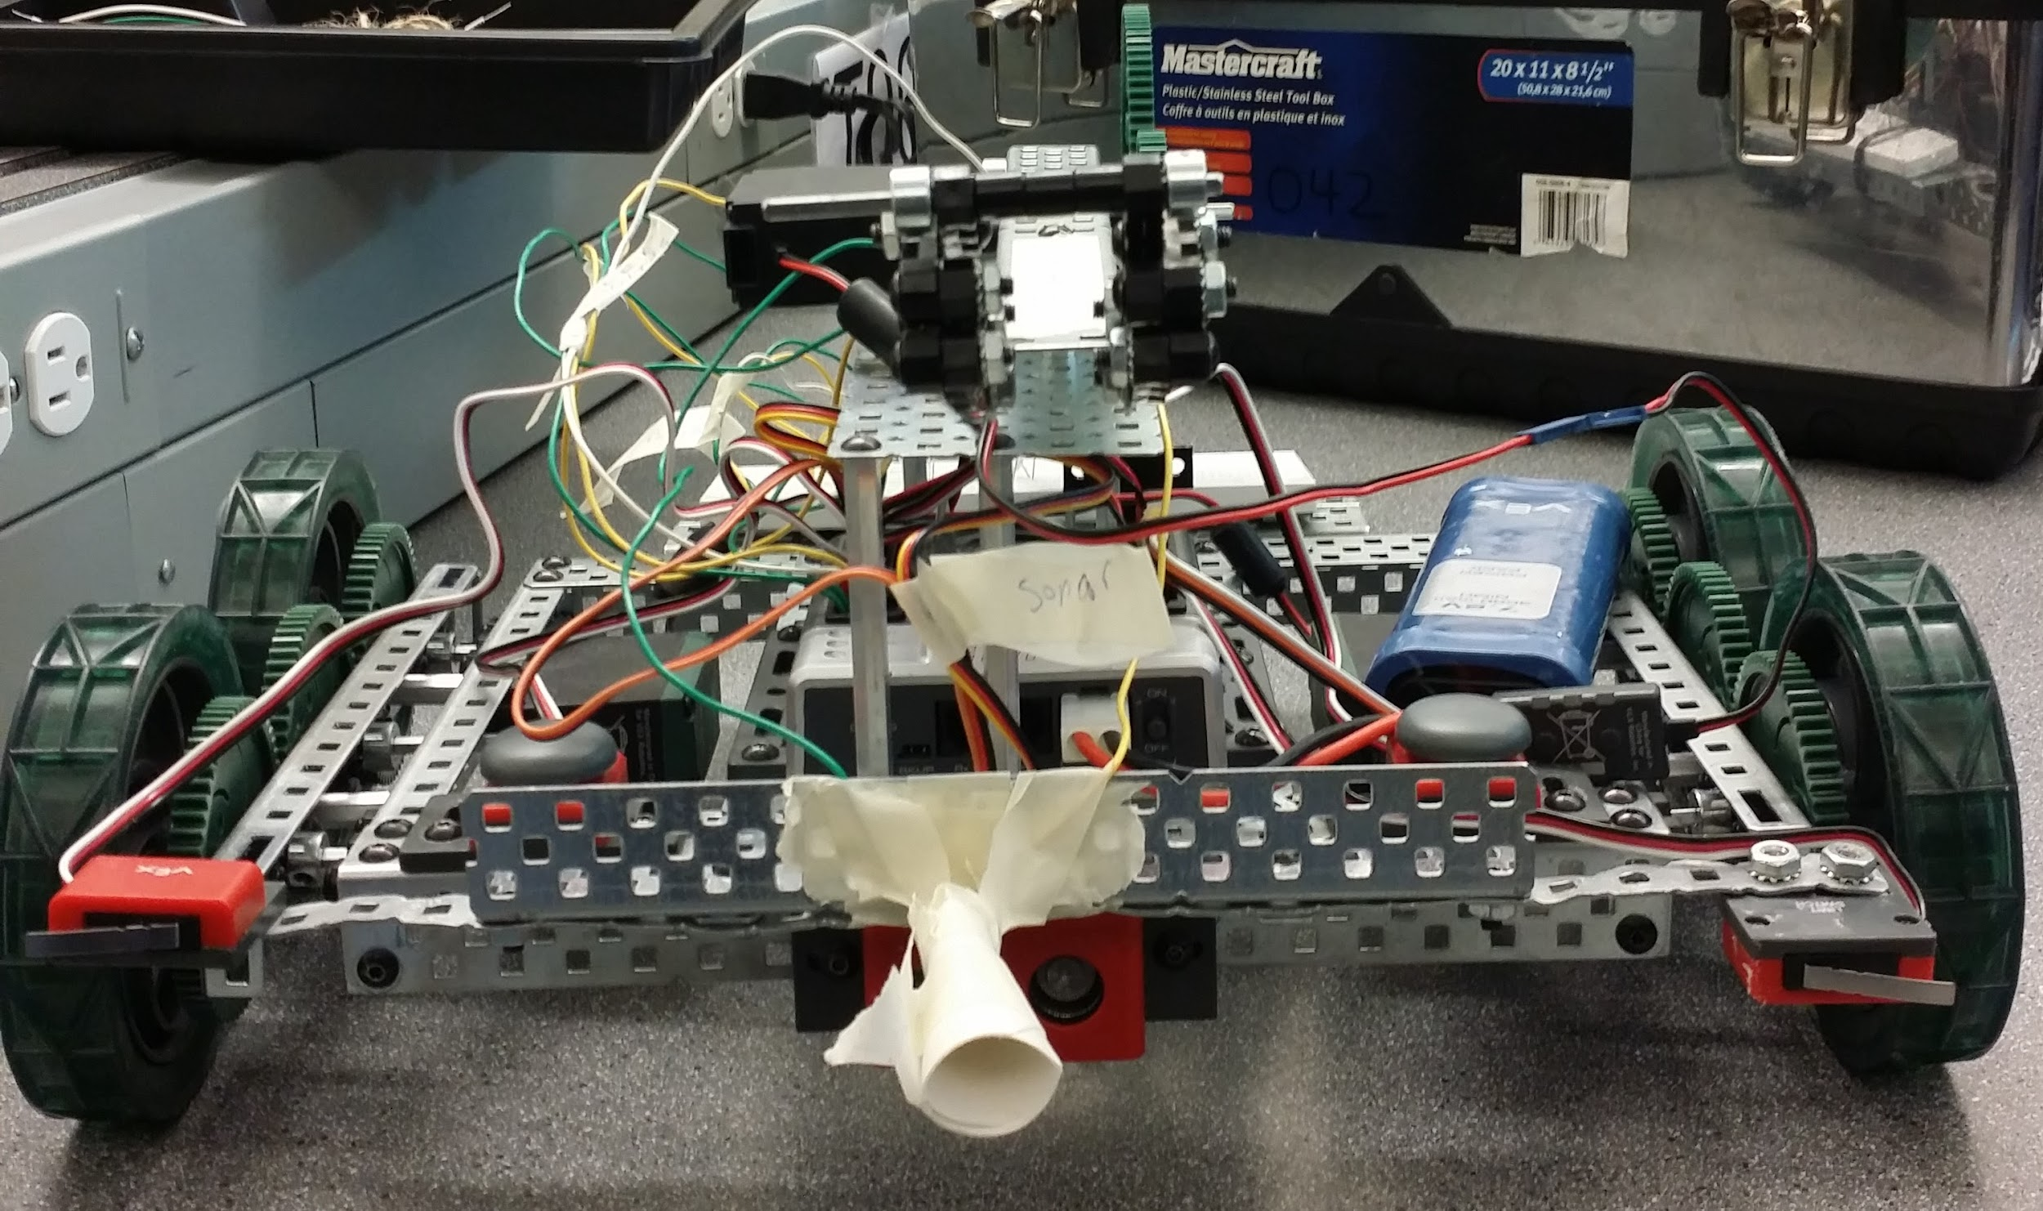
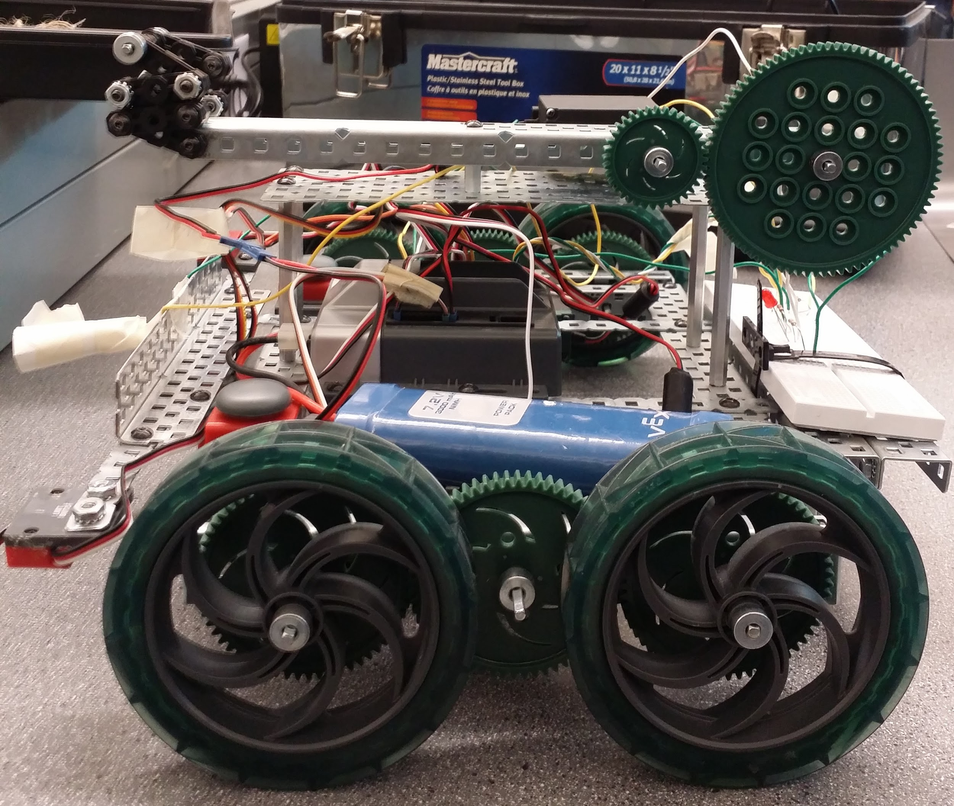
Vex Model G042
Has 2 buttons, 2 limit buttons, an ir sensor, and multiple motors and a mechanism for the wire attachment.
circuit with phototransistor
wire carrying mechanism
Basic wheel mechanism from the vet kit book
Multiple LED lights

Slide 10
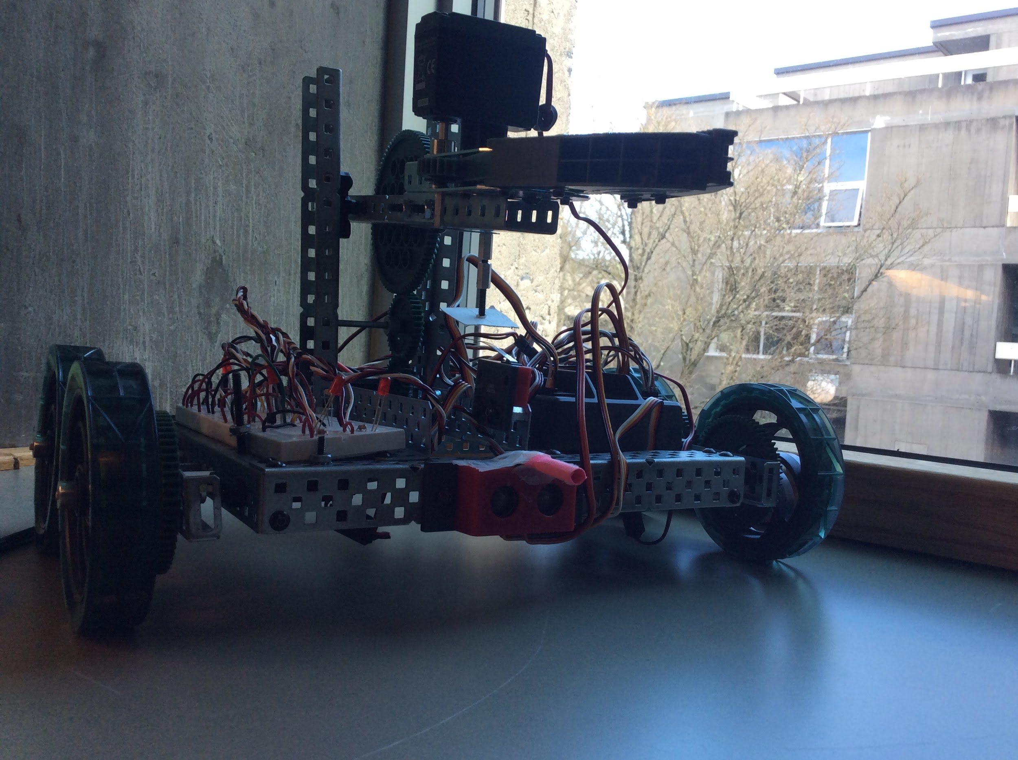
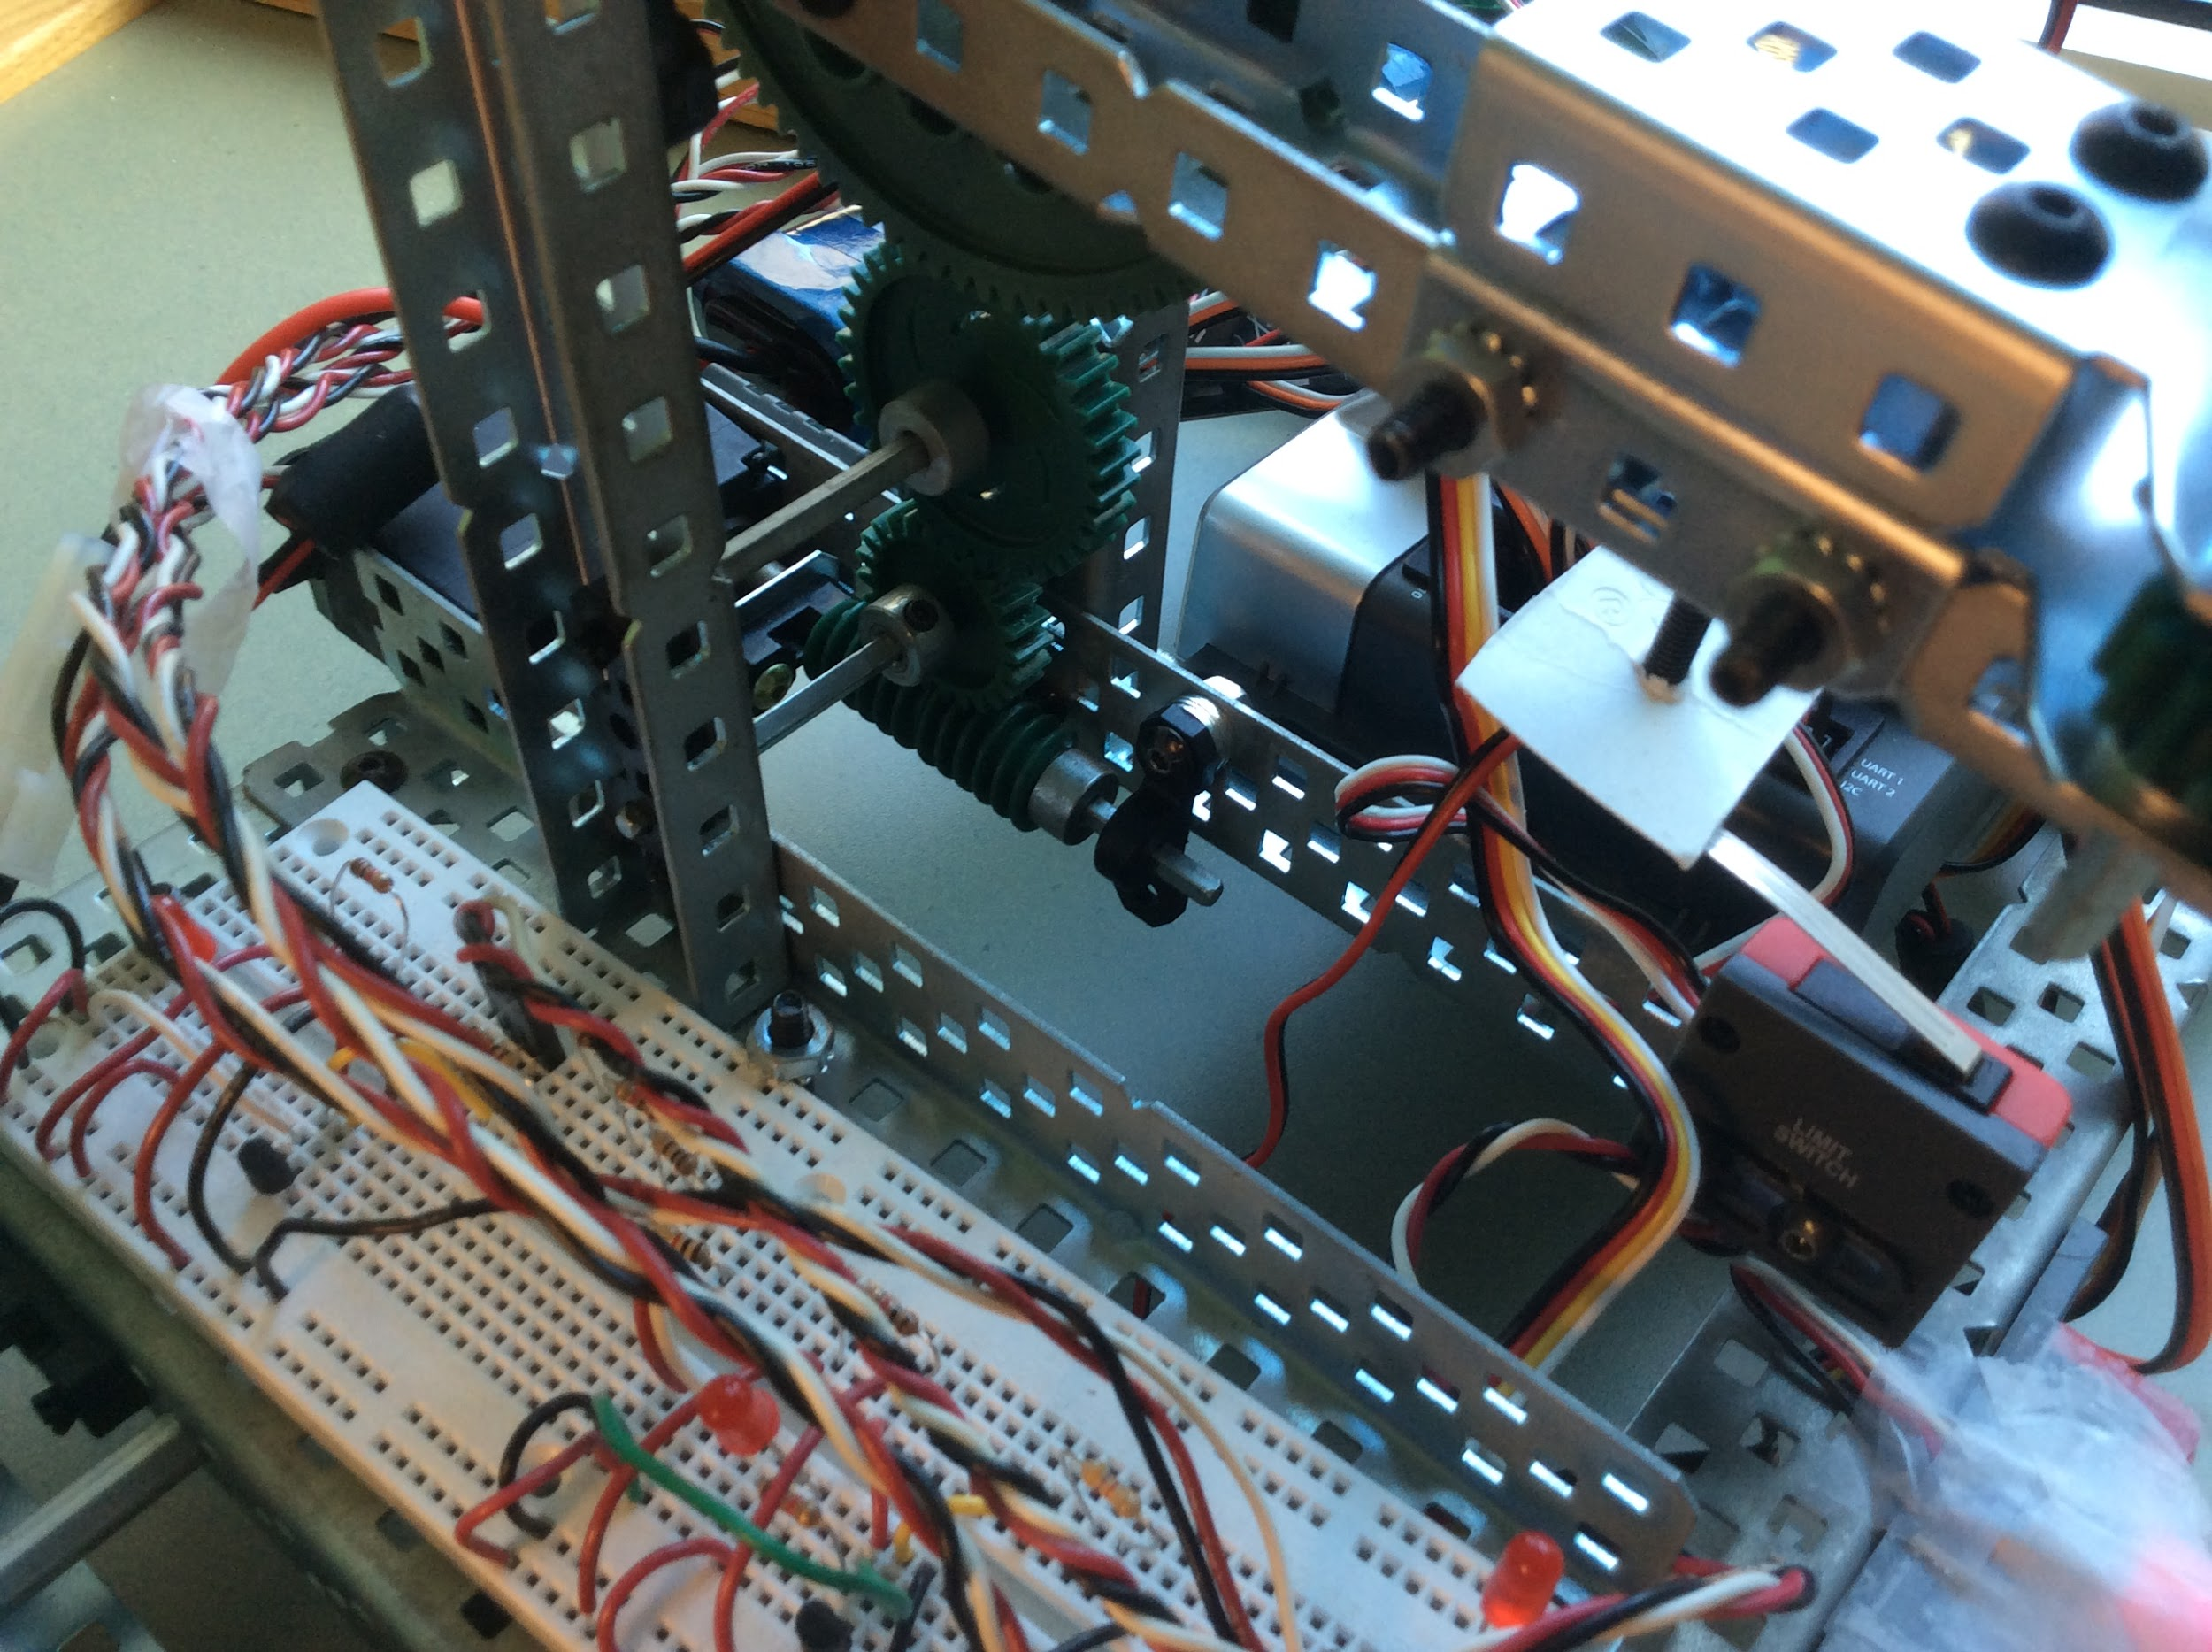
Vex Model G066
Features:
An ultrasonic collision avoidance system.
Twin infrared sensors.
Variable pathfinding.
Vertically adjustable claw for cable connection.
Arm-stopping mechanism.

Slide 11
Criteria | Weight | Vex Model G142 |  | Vex Model G042 |  | Vex Model G066
Reliability/Adaptability | 50% | 9 | 4.5 | 9 | 4.5 | 10 | 5
Durability/Stability | 15% | 6 | 0.9 | 7 | 0.9 | 8 | 1.2
Path Precision | 15% | 8 | 1.2 | 8 | 1.2 | 6 | 0.9
Creativity | 10% | 7 | 0.7 | 4 | 0.3 | 6 | 0.6
Cost Efficiency | 5% | 10 | 0.5 | 7 | 0.4 | 3 | 0.15
Mobility | 5% | 6 | 0.3 | 3 | 0.25 | 5 | 0.25
Total |  |  | 8.1 |  | 7.55 |  | 8.1
Weighted Objectives Matrix

Slide 12
Recommendation
Model: G412
Model: G066

Slide 13
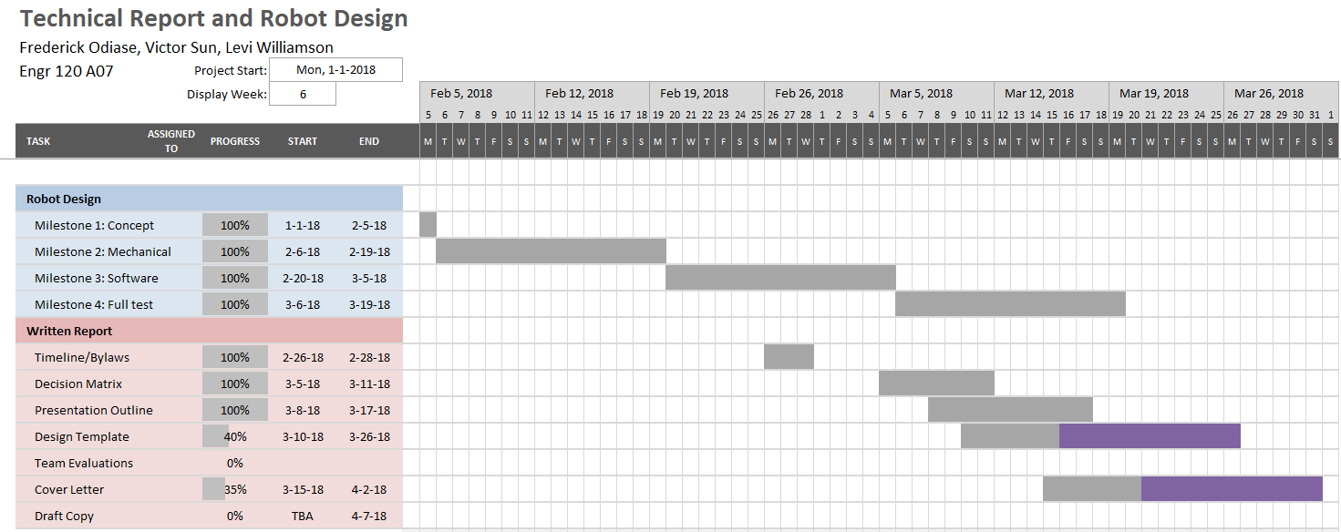
Written Report

Slide 14
Challenges

Slide 15
Problems with Robot and Technical Report
Having the robot detect the beacon in sunny conditions
Diagnostics/Troubleshooting
Loose wiring
Detecting beacon from across the arena
Consistent orientation with beacon
Meeting Issues due to midterms and Labs

Slide 16
Conclusion

Slide 17
Questions?
¿

